Slide 1
question 1: do campaign contributions lead to electoral success

Slide 2
Models
Decision Tree
Naive Bayes
Lazy Model: kNN

Slide 3
Evaluation Metrics
accuracy: =(# of right predictions) / (all predictions)
precision: true positives = (# of people labeled as winner and they are winners) / (# of people who are labeled as winners)
recall: (# of people labeled as winner and they are winner) / (# of all winners)
F-measure: consider both precision and recall

Slide 4
5-folds cross validation result
Table 1
 | Naive Bayes | Decision Tree | Lazy Model: kNN
accuracy | 0.899 | 0.894 | 0.852
precision | 0.854 | 0.849 | 0.959
recall | 0.950 | 0.95 | 0.806
F-measure | 0.900 | 0.897 | 0.876

Slide 5
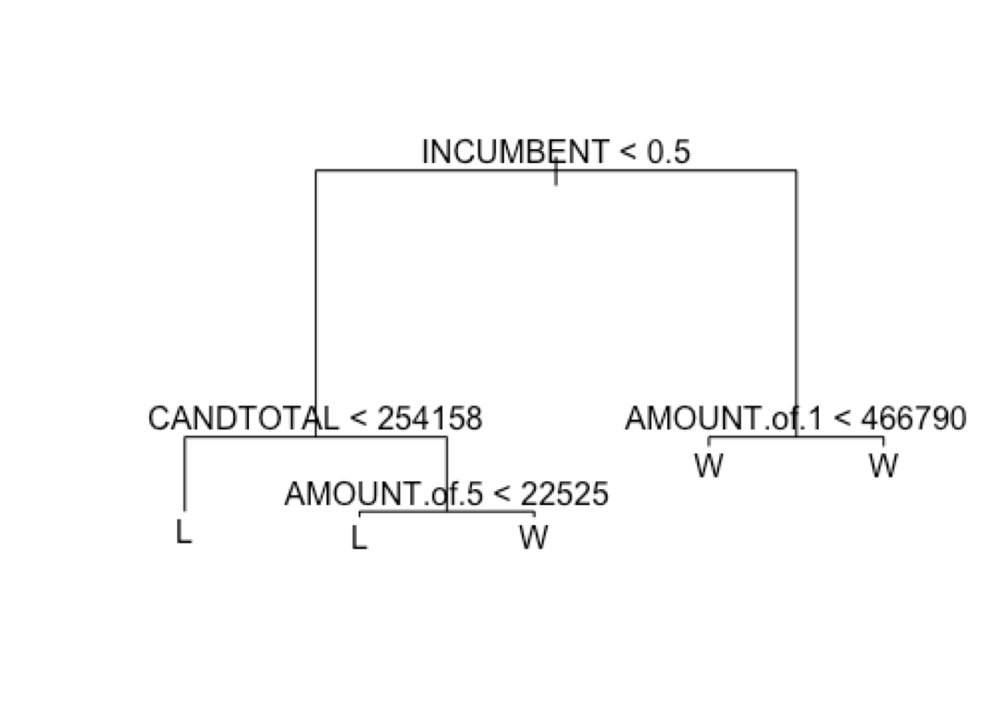
Another Interesting Thing
10-folds cross validation result

